Slide 1
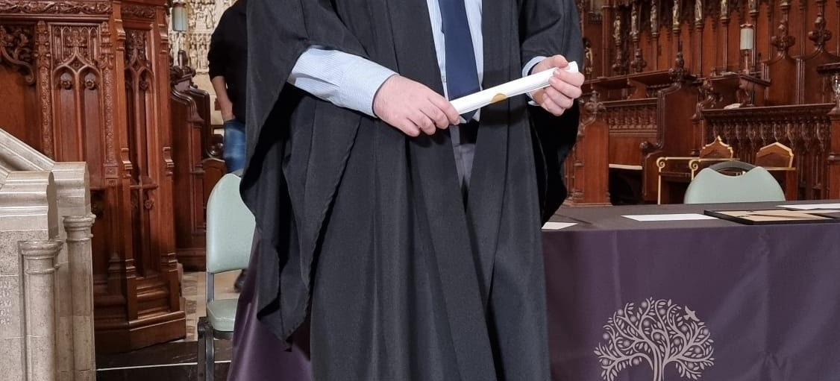
Peter Newing
BSc (Hons) Computing Technologies
Visit peternewing.com
https://www.peternewing.com

Slide 2

The Peter Repeater
YouTube channel
Open YouTube Channel
youtube.com/@nooneknowspeter

Slide 3

Jump Letters
Slide letters to make words
Google Play
App Store

Slide 4
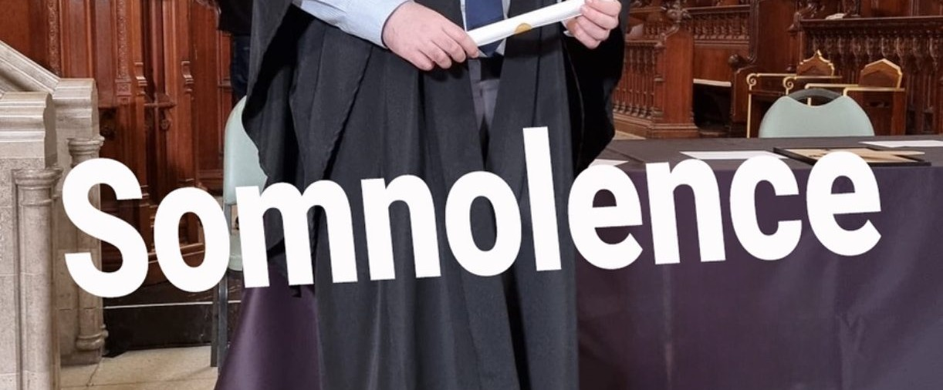
Somnolence
The Slow Way to Happiness
View on Amazon
Somnolence by Peter Newing on Amazon

